Slide 1
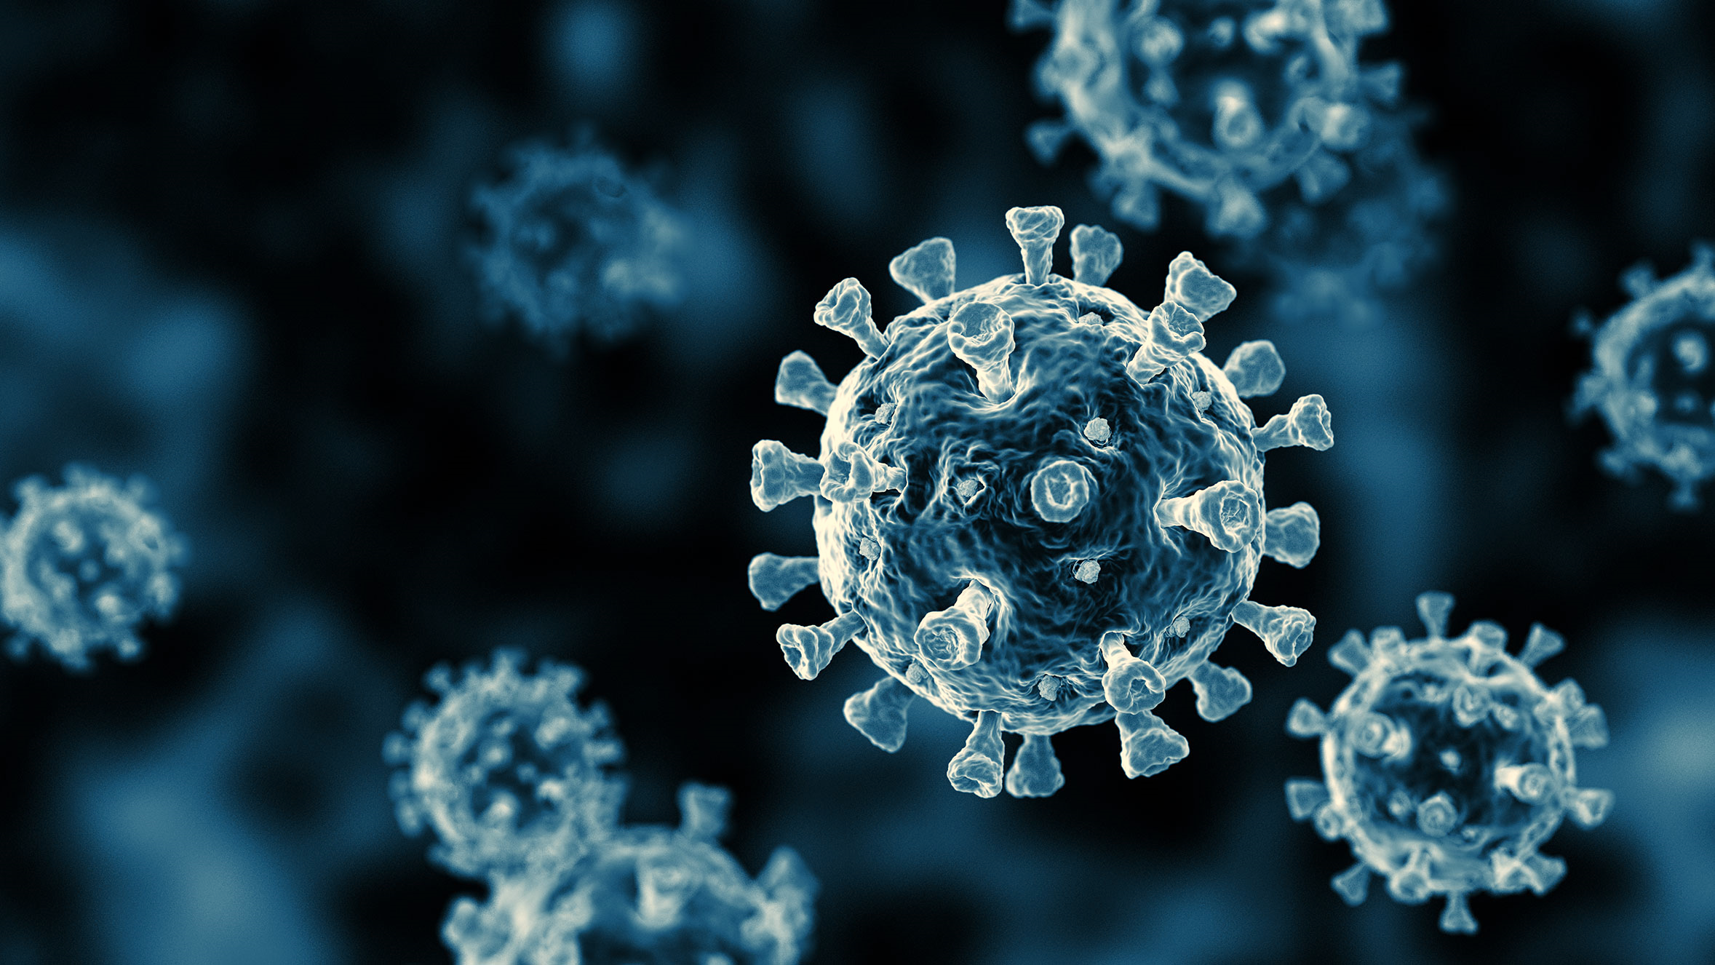
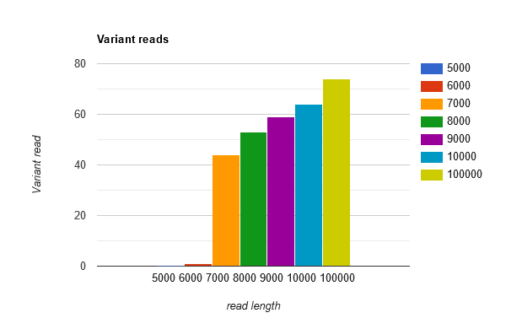
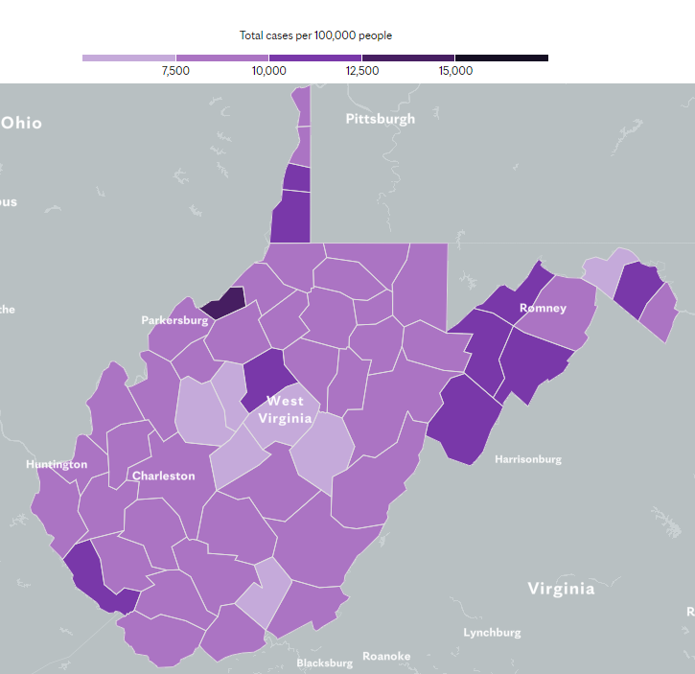
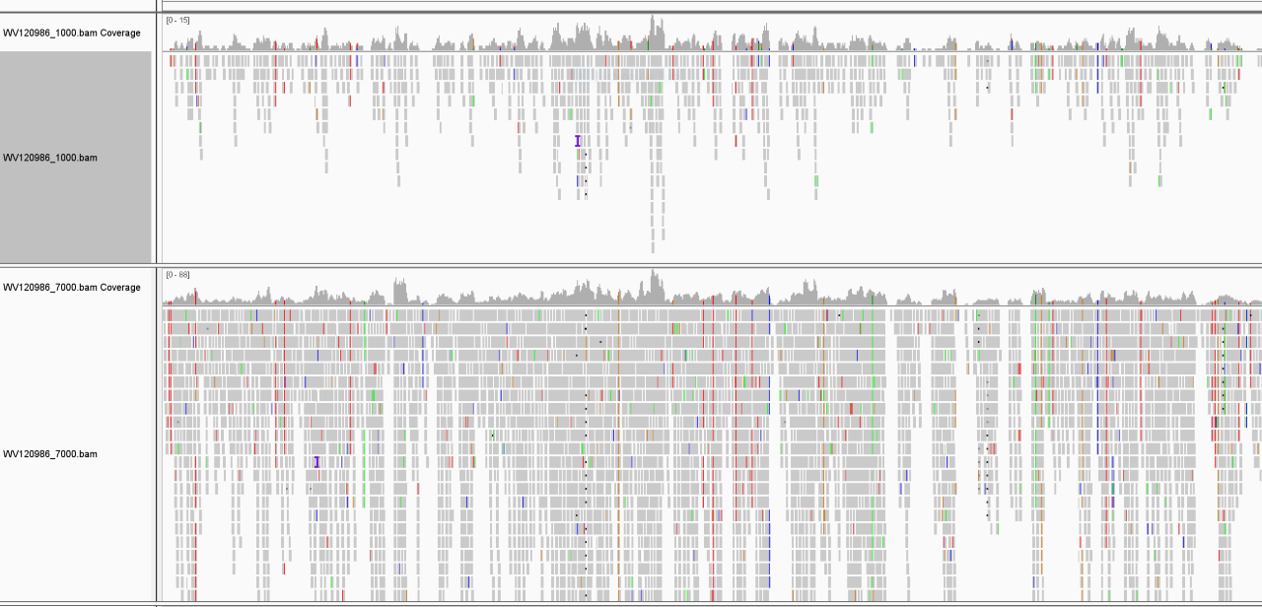
Testing Minimum Assembly Read Depth in SARS-CoV-2 Sequencing Analysis
Christopher Carver [1*], Sharmel Cavender [2*], Peter Stoilov [3], Pete Perrotta [4], Ryan Percifield [5], James Denvir [6†], Nicole Garrison [7†].
[1] Department of Science and Math, Glenville State College; [2] Department of Biology, University of Charleston; [3] Department of Biochemistry, West Virginia University; [4] Department of Pathology, West Virginia University; [5] Department of Biology, West Virginia University; [6] Department of Biomedical Sciences, Marshall University; [7] Department of Biomedical Sciences, West Liberty University.
Background
Detecting new variants of SARS CoV-2 is vital to keeping track of the evolution of COVID-19 and vital for public health safety. An example of one of the newest variants is the Delta variant, which is more contagious, especially among unvaccinated individuals, and can lead to extreme local outbreaks. Because of this, it is important to use adequate read depth insuring for adequate mapping and identifying any new variants in the emerging pathogens.
Methods
We took the West Virginia SARS-CoV-2 samples in Fastq file and ran them through BWA to map the alignments to the reference genome. From there, samtools indexed the Fastq files into bam files. We then fed those results into ivar to get the variants and pileups. Then, we were able to generate consensus files using ivar.
Discussion
In order to check the different read depths a custom Python script needed to be used. This was made allowing for the number of reads to be checked ranging between 1,000 to 3 million. By using this script, we found that the lowest number of reads for variant detection was 7,000 which had a read depth averaging 17.5. Anything below this was found to be undetectable which is unreliable. This is especially important for detecting mutations in the spike protein which are most responsible for the behavior in the SARS-CoV-2 virus.
Fastq
Fastq
Fastq
`
Introduction
Bioinformatics is science usually associated with “big data” that is heavy in biology, plus computer science, for how biological data is filtered, analyzed, organized, visualized, and interpreted. By developing and applying tools for analyzing large biological complex data with bioinformatics, the developing new COVID-19 variants can be detected for tracking, research, and informing the public health community. To accurately determine new variants the proper read depth is vital. Currently, variants are determined by utilizing the highest depth read available. We wanted to determine what is the lowest level of read depth that would still give us an acceptable mutation calling count using SARS-CoV-2 samples from West Virginia in order to run more tests at the same time.
Alignment
Fasta
Variant.tsv
BAM
Chart 1: variants detected at varying input read numbers for WV-SARS-CoV-2 samples.
Figure 2 shows the outline used to input the Fastq files all the way through the pipeline ending with the variant files.
Conclusions
We found that the lowest average read coverage depth acceptable for detecting new variants was 17.5. This shows that we can run a lower number of reads for samples allowing us to run more of them at one time. By being able to run the reads with better efficiency this also allows for more samples to be run permitting faster new variant detection.
References
1. Mayo Foundation for Medical Education and Research. West Virginia Coronavirus Map: Tracking the Trends. Mayo Clinic. https://www.mayoclinic.org/coronavirus-covid-19/map/west-virginia.
Figure 1 is a map of West Virginia representing the number of Covid 19 cases by county as of July 21, 2021. (1)
Figure 3. shows the igv visual representation of the read depth of 88 out of 100 for the West Virginia samples.

